Slide 1


Scrum-Agile
Chada Tech’s Way Forward

Slide 2
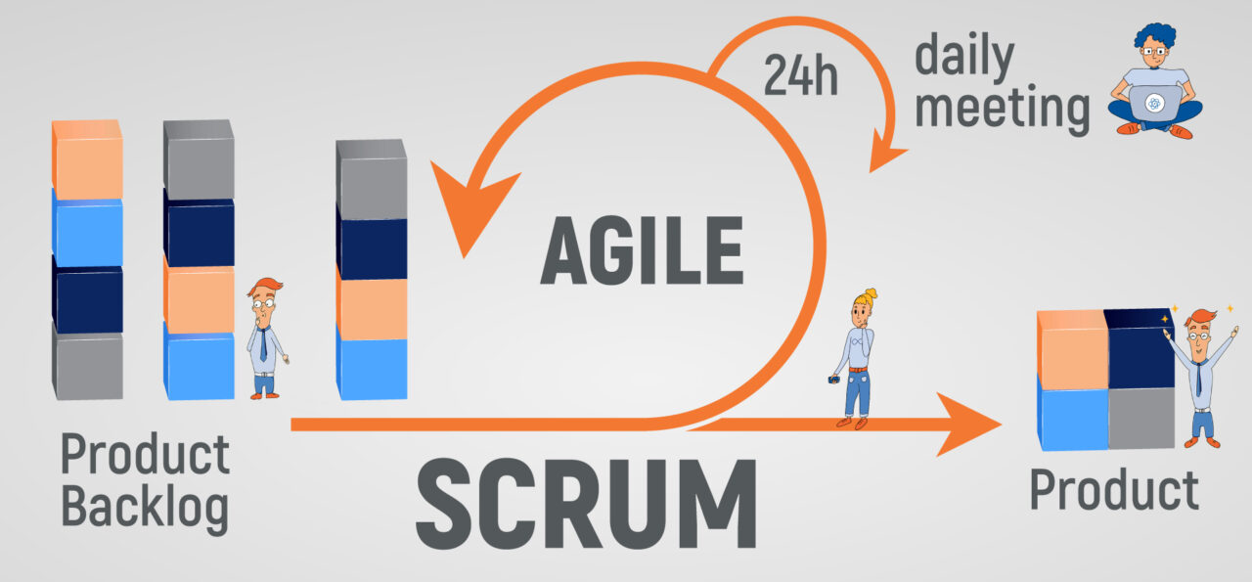
Scrum-Agile at a Glance
The idea of scrum is that is built on the idea of uncertain environments. Meaning that the process is created to be flexible and adjusted to changes that come down the line. This lends itself well to software development as a but can be applied to so many more aspects of business. It’s a way of tackling larger projects but in manageable chunks as apposed to looking at them as a monolithic venture.
Some of the core roles in a Scrum team are as follows:
Scrum Master
Product Owner
Developer
Tester

Slide 3
SDLC and Scrum-AGile
SNHU Travel Project
We had the opportunity to test run the scrum-agile framework on the SNHU travel site project. The team that worked on it had an overall great experience and was very adaptable even with last minute changes. The project was an overall success, and the stakeholders were very impressed with the end results. The team was more cohesive and communicative than in older iterations of projects.
In a typical SDLC cycle we end up with our requirements, design, coding, testing, deployments and maintenance spread out over a longer expanse of time. With agile, we see smaller chunks of the same project go through the entirety of the list save for maintenance (comes in a the end regardless) per sprint. Meaning with each workable portion of the project we do QA and testing and recap to ensure we are on task with the product vision that the stakeholders and scrum master set out.

Slide 4
Scrum Master
Coach team members on the agile process. Should have a decent knowledge base on how agile works and performs
Host the daily stand-up meetings and ensure that accountability is present with all team members
Will assist product owner with the product backlog (list of tasks yet to be completed)
Remove any roadblocks that the team might face. This can come from management or stakeholders wanting direct attention. This helps mitigate stoppages and distractions when focused on the end product.
Provides the vision for the project ahead

Slide 5
Product Owner
Defines the vision set forth by the scrum master into more manageable bits and pieces.
Manages the backlog as the main task, keeping the team in track to reach “done” state.
Prioritize what needs to get done ahead of other tasks. Will have to make the call on what aspects need to be dropped and which need to be focused on if the product scope changes.
Anticipates the clients needs and is the liaison between developers/testers and the stakeholders. Will mitigate distractions firsthand in order to keep developers and testers on task.
Evaluates where the team is in terms of progress and adjusts after retrospectives.

Slide 6
Developer
Talking through the requirements and ensuring to report and blocks during standups
Testing the software and creating fixes with amble notes
Implementing a system of maintenance for the systems that were created.
Being able to input information about timing and being transparent and forthright about timing needs.
Works closely with testers to ensure test cases are met

Slide 7
Tester
Helps define “done” or when the project has met all requirements
Assists in creating the scope of the project by evaluating test cases.
Design and execute test cases for each sprint and user story that requires it.
Setup automations for tasks that would offload time requirements from team members.
Verify and fixes generated by the developers and ensure a good followup.

Slide 8
Conclusion
Looking at how well the project turned out for our client SNHU I believe that we should make a strong push towards a scrum-agile process for future projects. Had we developed this with a waterfall approach we would have failed to complete within the time frame due to the last-minute change in project scope that was handed to us. We would have had to start the project over as we would have been to far into the initial project vision. This would have caused a huge delay to market causing our client to lose faith in us as one of their requirements was to beat their competitors to market. This would have caused a huge derailment in our progression, thankfully we were able to navigate soundly and get to the finish line without even changing finish dates.
This is not to say that waterfall no longer has a place with us. I think waterfall approaches work just fine with static based projects where we do not have many moving pieces or variables to disrupt said project. In this we can still maintain those simpler cut and dry approaches but for our bigger projects which can be chunked into smaller more manageable pieces we should move towards agile.

Slide 9
References
7 key product owner responsibilities. 7 Key Product Owner Responsibilities | Lucidchart Blog. (2020, June 11). Retrieved February 18, 2022, from https://www.lucidchart.com/blog/product-owner-roles-and-responsibilities
Agile software development with Scrum. K&C. (2021, September 29). Retrieved February 18, 2022, from https://kruschecompany.com/agile-software-development-with-scrum-framework/
The Scrum framework at a glance. The Scrum Framework at a glance. (n.d.). Retrieved February 18, 2022, from https://scrummate.com/agile-guide/scrum-framework/
Cobb, C. G. (2015). The Project Manager's Guide to Mastering Agile: Principles and practices for an adaptive approach. John Wiley.

